Slide 1
CONTENT RECOMMENDATION SYSTEM (CRS) ON AWS
Team-Oriented
Gunjan C
Harish S
Subham S
Sooriya A

Slide 2
WHAT IS CONTENT RECOMMENDATION SYSTEM?
Content recommendation system is a vital component of modern online platforms, allowing users to receive personalized content recommendations based on their preferences and behavior. This includes the development of various algorithms that utilizes collaborative filtering and deep learning techniques.

Slide 3
SERVICE RECOMMENDATION ENGINE
Our service recommendation system functions as a personalized guide, intuitively suggesting offerings aligned with each customer's unique interests and interactions on our website. It's a dynamic engine fueled by user behaviors, crafting tailored suggestions that resonate and elevate their experience seamlessly. By analyzing their journey through our platform, we curate recommendations that feel like they were made just for them.

Slide 4





AWS SERVICES USED TO BUILD AND OPERATE THE CRS

Slide 5
FACTOR CONSIDERED
SCALABILITY
PERFORMANCE
COST OPTIMIZATION

Slide 6
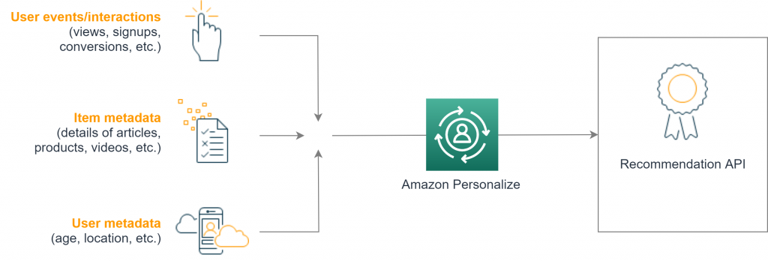
CONTENT RECOMMENDATION SYSTEM (CRS) ENGINE

Slide 7
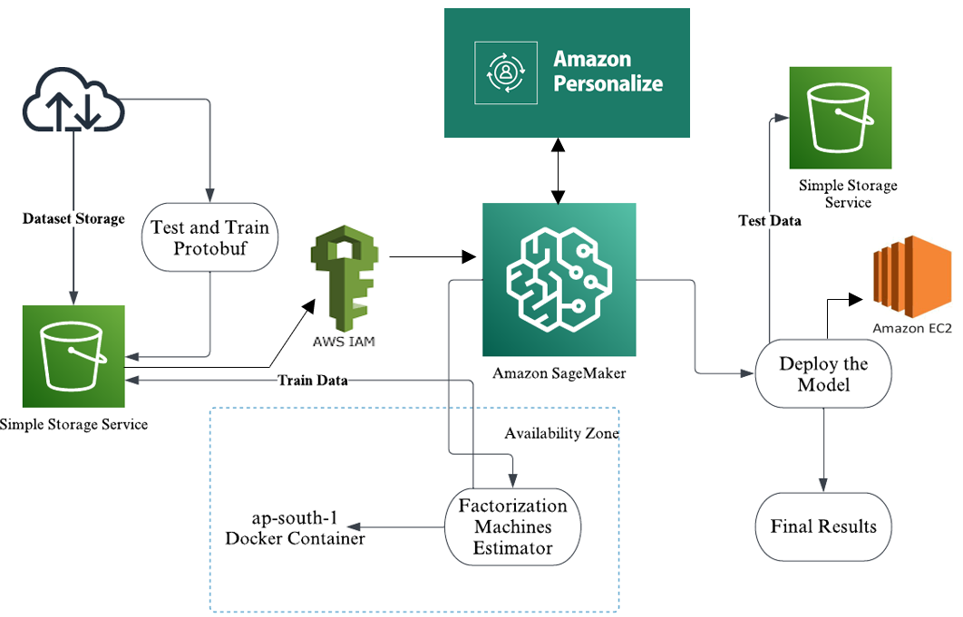
Architecture

Slide 8
REPORT ON EXISTING CONTENT RECOMMENDATION SYSTEM
Revolutionizing Product Recommendations &
Review Safety with Amazon Rekognition
Revolutionizing Review Safety
Enhancing Customer Trust
Efficiency & Cost Savings

Slide 9
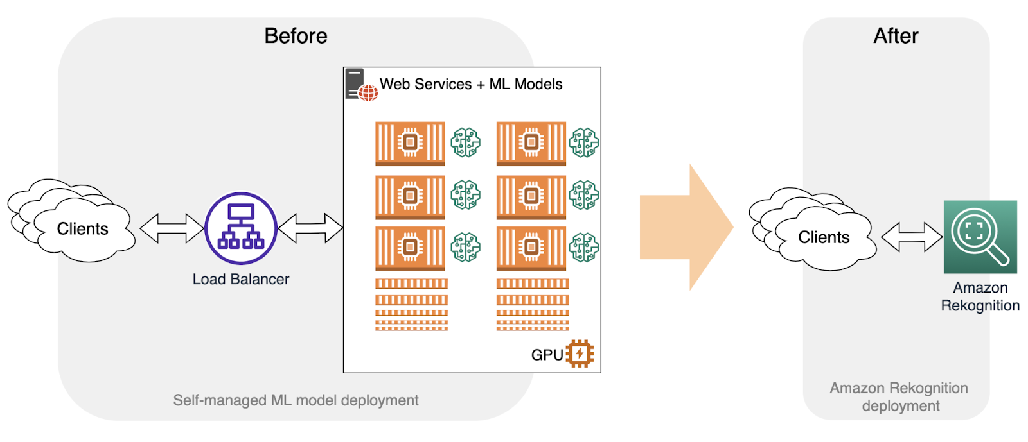
Efficient and Accurate Content Moderation
Streamlined Systems and Cost Savings

Slide 10
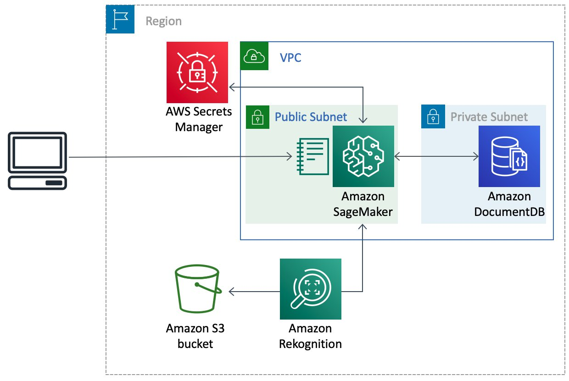

Slide 11
CONCLUSION
Efficient Review Moderation: Switching to Amazon Rekognition API streamlines moderation, ensuring swift, accurate review checks, enhancing customer experience by swiftly removing unsuitable content. This managed service not only saves costs but also eases the technical burden for businesses, offering customizable rules to meet specific requirements

Slide 12
THANK YOU

